Slide 1
Interfaces in Java
CS 21a: Introduction to Computing I First Semester, 2016-2017

Slide 2
Interfaces
Interface
Collection of method signatures with no bodies
Syntax public interface InterfaceName { public type methodName1(...); public type methodName2(...); }
A Java class may implement an interface public class ClassName implements InterfaceName { // define methodName1, methodName2,... here }

Slide 3
Two Types of Inheritance
Class inheritance (extends)
public class A extends B { ... }
Class A inherits fields and methods in class B
public methods of B can be invoked on A objects, unless overridden in A
Interface inheritance (implements)
Also called implementation inheritance
public class X implements Y { ... }
X must define all methods indicated in Y

Slide 4
Why use interfaces?
Interfaces enable and enforce "strict" sharing of methods among classes
Recall that superclass variables can refer to subclass objects
Suppose Y is an interface
Y var;
var can refer to an object of a class that implements Y
var.methodName(...) calls the actual method defined

Slide 5
Example: Shape
A Shape is anything that can be drawn: public interface Shape { public void draw(); }
Any class that implements Shape must implement the draw() method
Suppose Block, Triangle, and LetterT implement Shape
We can have an array of Shapes with elements referring to different kinds of objects
Use a loop to call draw() on all of the shapes

Slide 6
Example: Shape (and Block)
public class Block implements Shape {
private int size;
public Block( int s ) {
size = s;
}
public void draw() {
for( int i = 1; i <= size; i++ ) {
for( int j = 1; j <= size; j++ )
System.out.print("*");
System.out.println();
}
}
}
Because it implements Shape, this class will not compile unless draw() is defined.

Slide 7
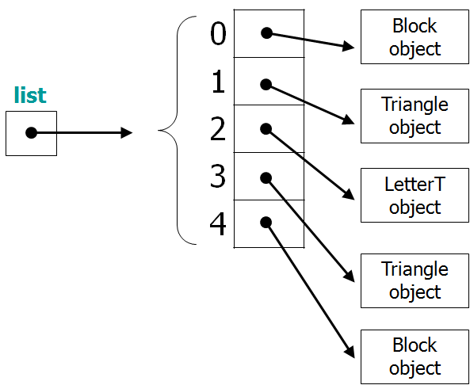
Example: Array of Shapes
Shape[] list;
...
for( int i = 0; i < 5; i++ )
list[i].draw();

Slide 8
Multiple Inheritance
Multiple (class) inheritance is not supported in Java public class A extends B1, B2, B3 {...}
But a class may implement multiple interfaces public class X implements Y1, Y2, Y3 {...}
✘ will not compile
✔ will compile, but X must define methods in Y1, Y2, and Y3

Slide 9
About Interfaces
Interfaces cannot be instantiated Shape s = new Shape(); ✘
Interfaces can be extended
public interface Y1 extends Y2 {...}
public class X implements Y1 {...} X must define methods indicated in Y1 and Y2
Interfaces cannot declare instance fields and may not have any method definitions
Use an abstract class instead

